Slide 1

Introduction to Object Oriented Programming
Basic programing constructs
Notes:
NOTE:
To change the image on this slide, select the picture and delete it. Then click the Pictures icon in the placeholder to insert your own image.

Slide 2
Topics
Why use OOP?
Building blocks of OOP
Classes
Objects
Access Specifiers
What is OOP?
OOP concepts
Abstraction
Encapsulation
Inheritance
Polymorphism
Advantages vs Disadvantages
Conclusion

Slide 3
Why use OOP?
Object Oriented Programming (OOP) is one of the most widely used programming paradigm
Why is it extensively used?
Well suited for building trivial and complex applications
Allows re-use of code thereby increasing productivity
New features can be easily built into the existing code
Reduced production cost and maintenance cost​
Common programming languages used for OOP include C++, Java, and C#

Slide 4
Building Blocks of OOP: Objects & Classes
Object: models a
Real world object (ex. computer, book, box)
Concept (ex. meeting, interview)
Process (ex. sorting a stack of papers or comparing two computers to measure their performance)​
Class: prototype or blueprint from which objects are created

Slide 5
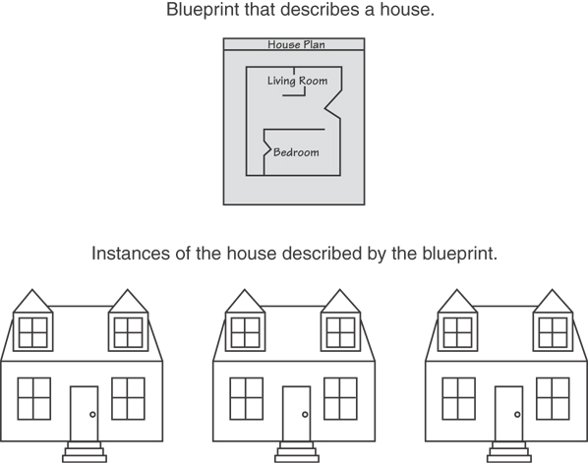
Building Blocks of OOP: Objects & Classes
A Class is like a blueprint and objects are like houses built from the blueprint

Slide 6
Building Blocks of OOP: Objects & Classes
Class has
Set of attributes or properties that describes every object
Set of behavior or actions that every object can perform​
Object has
Set of data (value for each of its attribute)
Set of actions that it can perform

Slide 7
Creating a Class
Objects are created from a class
Format:
class ClassName
{
declaration;
declaration;
};

Slide 8
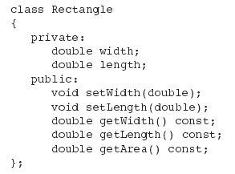
Classic Class Example

Slide 9
Access Specifiers
Used to control access to members of the class
public: can be accessed by functions outside of the class
private: can only be called by or accessed by functions that are members of the class
In the example on the next slide, note that the functions are prototypes only (so far)

Slide 10
Class Example

Slide 11
Access Specifiers
Private Members
Public Members

Slide 12
Access Specifiers (continued)
Can be listed in any order in a class
Can appear multiple times in a class
If not specified, the default is private

Slide 13
Constructors
Member function that is automatically called when an object is created
Purpose is to construct an object and do initialization if necessary
Constructor function name is class name
Has no return type specified
(What is the real return type?)

Slide 14
Overloading Constructors
A class can have more than one constructor Overloaded constructors in a class must have different parameter lists:
Rectangle(); Rectangle(double);
Rectangle(double, double);

Slide 15
Destructors
Member function automatically called when an object is destroyed
Destructor name is ~classname, e.g., ~Rectangle
Has no return type; takes no arguments
Only one destructor per class, i.e., it cannot be overloaded
If constructor allocates dynamic memory, destructor should release it

Slide 16
Constructors, Destructors, and Dynamically Allocated Objects
When an object is dynamically allocated with the new operator, its constructor executes: Rectangle r = new Rectangle(10, 20);
When the object is destroyed, its destructor executes: delete r;

